Slide 1
Part IV
Elementary Statistical Methods
Inferential Statistics

Slide 2
Data
Statistics
collect
organize
summarize
analyze
To draw a conclusion
with a degree of confidence.
Chapter 6_part 2 Sampling distribution
Probability
Inferential Statistics

Slide 3
Elementary Statistical Methods
Chapter 6 part 2
Sampling Distribution
Slides are Made by
Tamer Oraby
UTRGV

Slide 4
Outline:
1. Simple random sample (SRS).
2. Sums of independent and identically normally distributed r.v.
3. Central limit theorem (CLT).
4. Sampling distribution of the sample mean $\overline{X}$.

Slide 5
Sampling Distribution of $\overline{X}$
We are going to show (without proofs) … the sample mean
The population is normal or approximately normal (use Normal Q-Q plot to check it out).
OR
The sample size n is sufficiently large (practically speaking n ≥ 30), based on Central Limit Theorem (CLT).

Slide 6
Population
Sample
Sample size is
denoted by n
Population: a collection or a group of individuals or items.
Populations are finite or infinite (very large).
Sample: a sub-collection of population.

Slide 7
Simple Random Sample (SRS): a sample whose elements are selected randomly from a population such that any two samples of the same size (n) have the same probability to be selected.

Slide 8
Simple Random Sample (SRS): a sample whose elements are selected randomly from a population such that any two samples of the same size (n) have the same probability to be selected.
Random Sample of size n=5
Population

Slide 9
Simple Random Sample (SRS): a sample whose elements are selected randomly from a population such that any two samples of the same size (n) have the same probability to be selected.
Random sample of size n=5
Population
Another random sample of size n=5
If both random samples have the same probability to be selected, then they are SRS.
That is both are equally likely to occur.

Slide 10
Random sampling is a random experiment.
Numerical summaries of random samples (which we call statistics) are random variables, since they are numerical outcomes of random experiments.
Values of a statistic of Simple Random Samples (SRS) are equally likely to be observed.
The probability distribution of a statistic is called sampling distribution.
Here we will focus on the statistic $\overline{X}$ as a random variable and study its sampling distribution.

Slide 11
First the mean and standard deviation of the sample mean $\overline{X}$

Slide 12
Population
Sample
Sample size is
denoted by n
If a variable of the population has mean $μ$ and standard deviation $σ$ …
… then the mean and standard deviation of the sample mean $\overline{X}$ are given by
$$μ_{\overline{X}}=μ$$
and
$σ_{\overline{X}}=\frac{σ}{\sqrt{n}}$

Slide 13
Second the sampling distribution of the sample mean $\overline{X}\sim ???$

Slide 14
Population
Sample
Sample size is
denoted by n
If a variable of the population is normally distributed …
… then the variable of the random sample is also normally distributed.

Slide 15
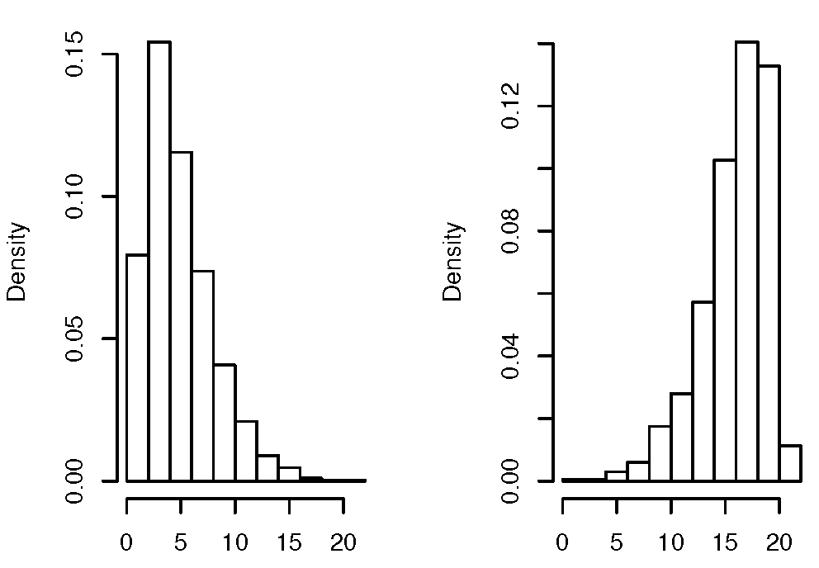
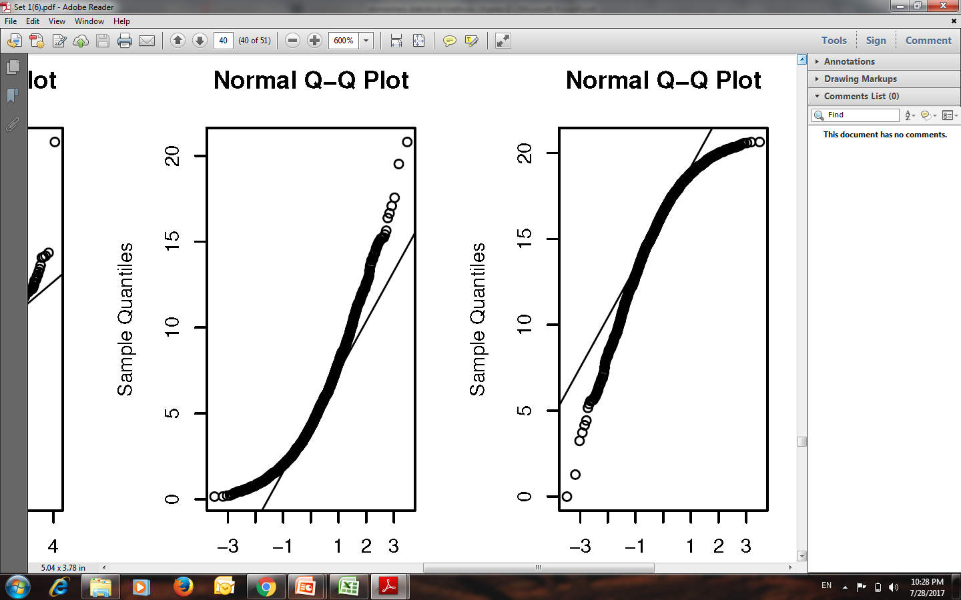
Assessing Normality
Normally distributed

Slide 16
Example :
Assess normality of the following SRS
44.5 | 48.5 | 42.2 | 46.2 | 45.7 | 44.8 | 38.9 | 43.3 | 39.5
45.4 | 43 | 38 | 44.7 | 38.6 | 41.6 | 41.9 | 34 | 46.9
39.6 | 44.7 | 36.5 | 42.7 | 40.6 | 47.5 | 42.6 | 48.4 | 37.5
45.5 | 38 | 41.2 | 40.5 | 44.4 | 42.6 | 44.6 | 42 | 40.3
39 | 42.2 | 38.5 | 43.6 | 40.6 | 45 | 42.3 | 40.7 | 36.3
38 | 37.6 | 42.2 | 40.3 | 48.5 | 41.6 | 36 | 41.7 | 34
39.5 | 38 | 41.3 | 38.8 | 41.9 | 40.3 | 36 | 42.1 | 33
42.3 | 44.6 | 38 | 37.4 | 44.5 | 40.7 | 37 | 38.2
44 | 35.9 | 43.7 | 48.1 | 38.7 | 46 | 37 | 43.4
37.7 | 34.6 | 42.4 | 42.7 | 47 | 42.8 | 34 | 39.9

Slide 17
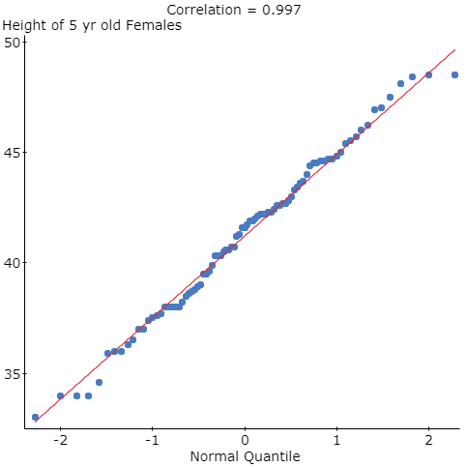
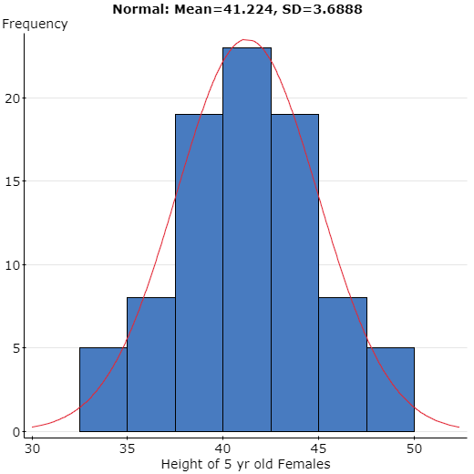
Normal Q-Q plot
Histogram of the variable

Slide 18
What if the population is not normally distributed?

Slide 19
Central Limit Theorem (CLT):
If the population has a finite standard deviation $σ$, then the limit distribution of $\frac{\overline{X}−μ}{σ/\sqrt{n}}$ (as n tends to infinity) is the standard normal distribution $N(0,1)$.
As a consequence: for sufficiently large sample size n (practically speaking when $n≥30$)
$\overline{X}$ is approximately following $N(μ,\frac{σ}{\sqrt{n}})$.

Slide 20
Sampling Distribution of $\overline{X}$
The population is normal or approximately normal (use Normal Q-Q plot to check it out).
OR
The sample size n is sufficiently large (practically speaking n ≥ 30), based on Central Limit Theorem (CLT).

Slide 21
Remark:
1. If neither the population is normally distributed nor n is larger than 30 then the sampling distribution of $\overline{X}$ can have other forms and other methods to carry out inferential statistics are warranted. We don’t pursue that case here.
2. For single individual $X\sim N(μ,σ)$ is also a special case of the sampling distribution of $\overline{X}$ when $n=1$ as

Slide 22
Example :
Since n is smaller than 30, then we need the population to be
normally distributed with mean $μ=64$ and standard deviation $σ=17$;
that is,
$$X\sim N(64,17)$$
and when that is true, then
$$\overline{X}\sim N(64,\frac{17}{\sqrt{20}})$$

Slide 23
$$\overline{X}\sim N(64,\frac{17}{\sqrt{20}})$$
Example: (Cont’d)
$$P\left(\overline{X}<67.3\right)=normalcdf\left(−∞,67.3, 64, \frac{17}{\sqrt{20}}\right)=.81$$
$$P\left(\overline{X}≥65.2\right)=normalcdf\left(65.2, ∞, 64, \frac{17}{\sqrt{20}}\right)=.38$$

Slide 24
Example:
$$X\sim N\left(266, 16\right) days$$
$$P\left(X<260\right)=normalcdf\left(−∞,260, 266, 16\right)=.35$$
Since the population is approximately normally distributed then
$\overline{X}\sim N(266,\frac{16}{\sqrt{20}})$ days

Slide 25
Example: (Cont’d)
$\overline{X}\sim N(266,\frac{16}{\sqrt{20}})$ days
$$P\left(\overline{X}≤260\right)=normalcdf\left(−∞,260, 266, \frac{16}{\sqrt{20}}\right)=.047$$
$$\overline{X}\sim N\left(266,\frac{16}{\sqrt{50}}\right) days$$
$$P\left(\overline{X}≤260\right)=normalcdf\left(−∞,260, 266, \frac{16}{\sqrt{50}}\right)=.004$$
I would be surprised since it is rare.

Slide 26
$$\overline{X}\sim N\left(266,\frac{16}{\sqrt{15}}\right) days$$
$P\left(266−10<\overline{X}<266+10\right)=$ $P\left(256<\overline{X}<276\right)$
$=normalcdf\left(256, 276, 266, \frac{16}{\sqrt{15}}\right)=.985$

Slide 27
Example :
$$X\sim N\left(43.7, 4.2\right) cm$$
$$P\left(X<40\right)=normalcdf\left(−∞,40, 43.7, 4.2\right)=.189$$
$$\overline{X}\sim N\left(43.7,\frac{4.2}{\sqrt{9}}\right) cm$$
$$P\left(\overline{X}<40\right)=normalcdf\left(−∞,40, 43.7,\frac{4.2}{\sqrt{9}}\right)=.004$$

Slide 28
$$\overline{X}\sim N\left(43.7,\frac{4.2}{\sqrt{12}}\right) cm$$
$$P\left(\overline{X}<40\right)=normalcdf\left(−∞,40, 43.7,\frac{4.2}{\sqrt{12}}\right)=.001$$
It decreases, as the standard deviation decreases from 4.2 to 1.4
and then to 1.2.

Slide 29
Given that the actual mean is $μ=43.7$, the probability to observe a
sample mean of 46 cm or even the more extreme (for a sample of size n=15)
is given by
$$P\left(\overline{X}≥46\right)=normalcdf\left(46,∞, 43.7,\frac{4.2}{\sqrt{15}}\right)=.017$$
$$<0.05$$
Yes it is unusual.

Slide 30
End of Chapter 6 part 2

